Slide 1



Analysis of Variance (ANOVA)
MSc. Kian Jenab
PhD student
Devision of Terrestrial Ecosystem Research
Centre for Microbiology and Environmental Systems Science
University of Vienna
Email: kian.jenab@univie.ac.at

Slide 2
ANOVA (Analysis of Variance)
Difference between means of more than two groups or population
(µ₁, µ_{2,} µ_{3,} µ_{4,.....} µ_{n})
H₀: There is no difference between means of groups(µ₁= µ₂ = µ₃ = µ₄ )
P > or = 0.05
H₁: There is significant difference between at least means of two populations
P < 0.05

Slide 3
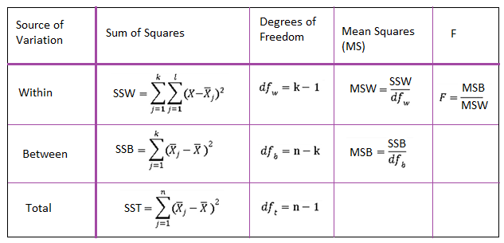
F (dfw, dfb) = x

Slide 4
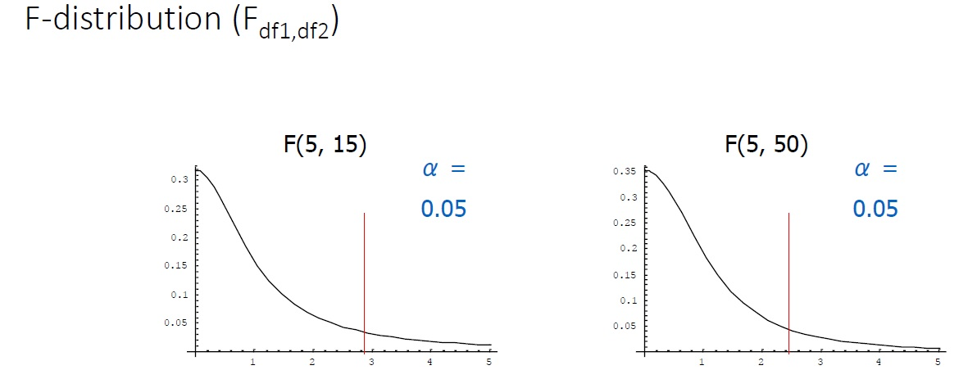

Slide 5
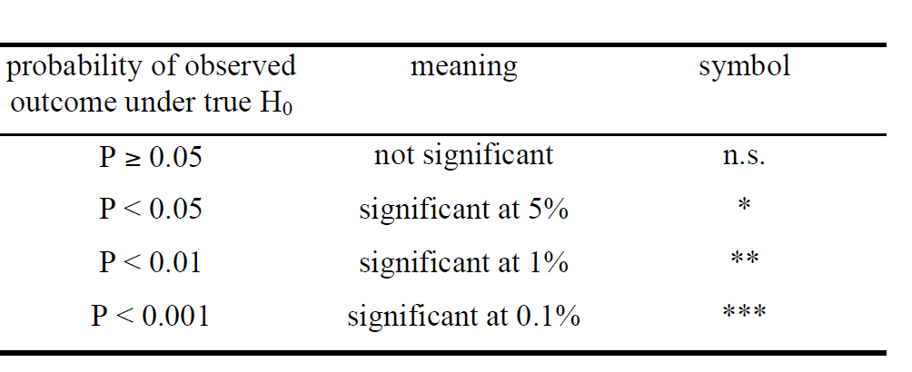
One-way ANOVA (Analysis of Variance)
Post hoc tests (Ex: LSD, Tukey, Duncan.....)
Determine difference between groups
H₀: No difference
P > or = 0.05
H₁: Significant difference
P < 0.05

Slide 6
ANOVA Assumptions
Normal distribution between groups
H₀: Normal distribution
P > or = 0.05
H₁: Other distributions
P < 0.05
Homogeneity of Variance
H₀: No difference in groups’ variance
P > or = 0.05
H₁: Difference in groups’ variance
P < 0.05

Slide 7
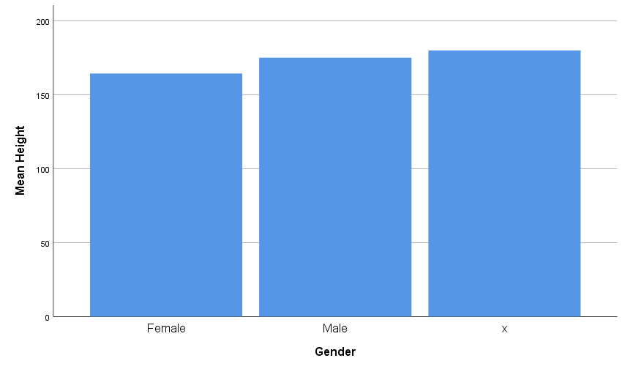
b
c
a

Slide 8
c
ac
b

Slide 9
ANOVA Report
One-way ANOVA was performed to compare the effect of categorical variable on numeric variable.
One-way ANOVA revealed that there [was or was not] a statistically significant difference in numeric variable between at least two groups (F (between groups df, within groups df) = F-value, p = p-value).
Tukey’s HSD Test for multiple comparisons found that the mean value of numeric variable was significantly different between group name 1 and group name 2 (p = p-value).
There was no statistically significant difference between group name 1 and group name 3 (p= p-value).

Slide 10
Welch-test
Comparison between different independent groups
If:
Normal distribution between groups
Homogeneity of Variance

Slide 11
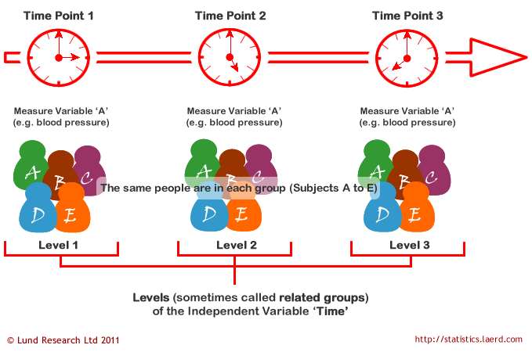
Paired (Repeated Measures) ANOVA

Slide 12
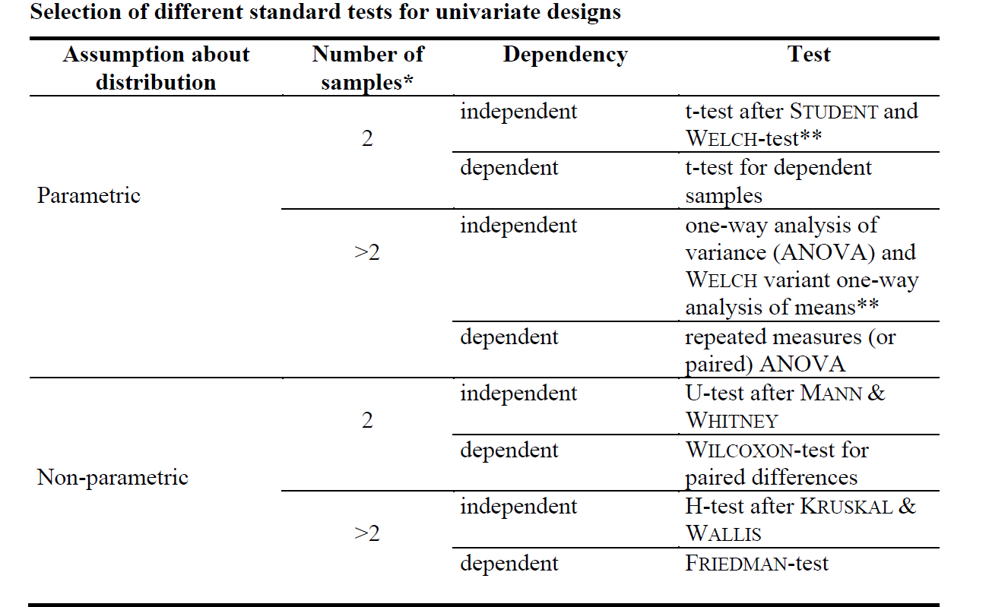

Slide 13
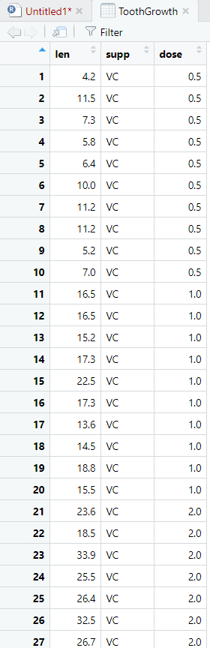


Slide 14
Two-way ANOVA
Two or more different categorical factors have to be considered simultaneously
growth of bacteria
1) A difference in growth between nutrient levels, e.g. Grow better in high carbon (Main Factor)
2) A difference in growth between temperature levels, e.g. Grow better in higher temperatures (Main Factor)
3) A difference in Nutrient level among temperature levels, e.g. Bacteria prefer low carbon nutrients in higher temperatures (Interaction)
Nutrient Level
Low Carbon
High Carbon
Temperature
20 °C
30 °C
40 °C

Slide 15
Two-way ANOVA
Interaction means the dependence of the effect of one factor on the level of another factor
Inhibition a level of one factor negatively influences the effect of the other factor
Synergism a level of one factor positively influences the effect of the other factor
Assumption:
Check normal distribution of continuous response variable within each group
A group is defined by one nutrient level and temperature combination, thus we have 6 groups
Check variance homogeneity across all groups (sex/food combinations)
Variances of all (6) groups should be of similar magnitude.

Slide 16
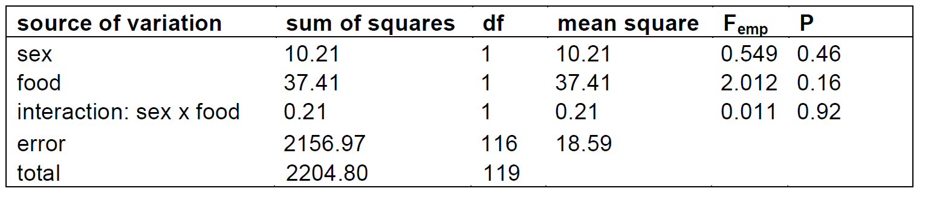
Hypothesis
1. H₀ : no difference between Nutrient levels.
2. H₀ : no difference between temperatures.
3. H₀ : no interaction.

Slide 17
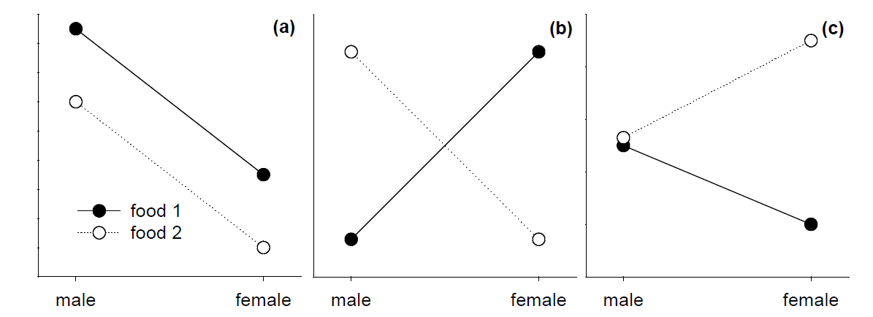

Interaction plot

Slide 18


